Slide 1


Slide 3
Wow
I
Never
Anticipated
Having an
Opportunity
Regarding
Such an
Exceptional quality horse!

Slide 4
And here is why I should win …

Slide 5
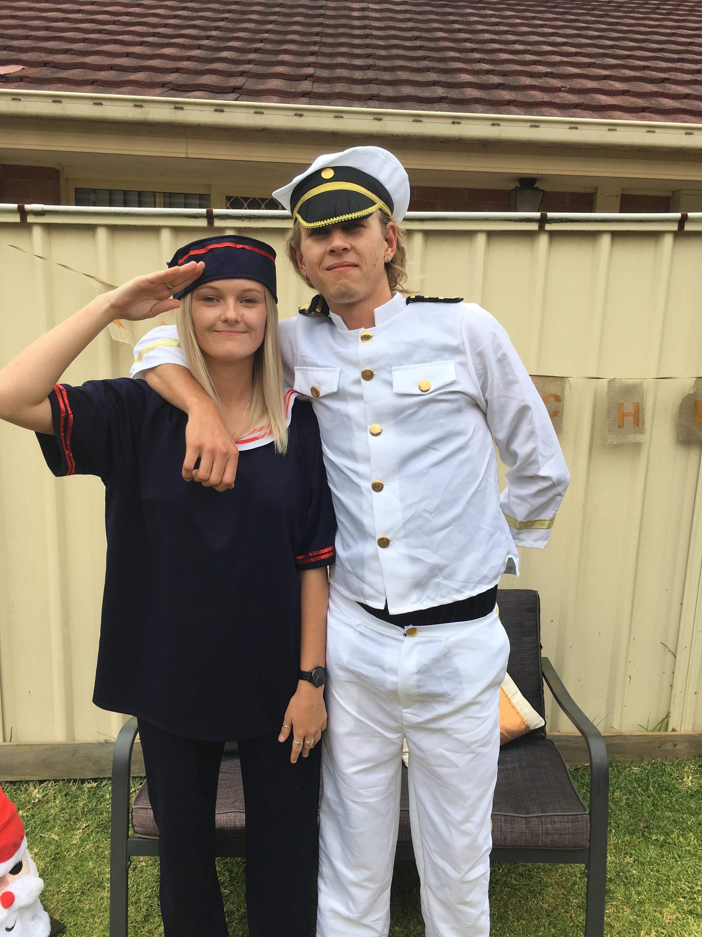
These are my kids and they're all grown up now…

Slide 6
And these are my new babies,
Just a little bit fancy
“Fancy”
Crystal parks nights in cisco
“Squirt”
There’s only one thing missing…

Slide 7
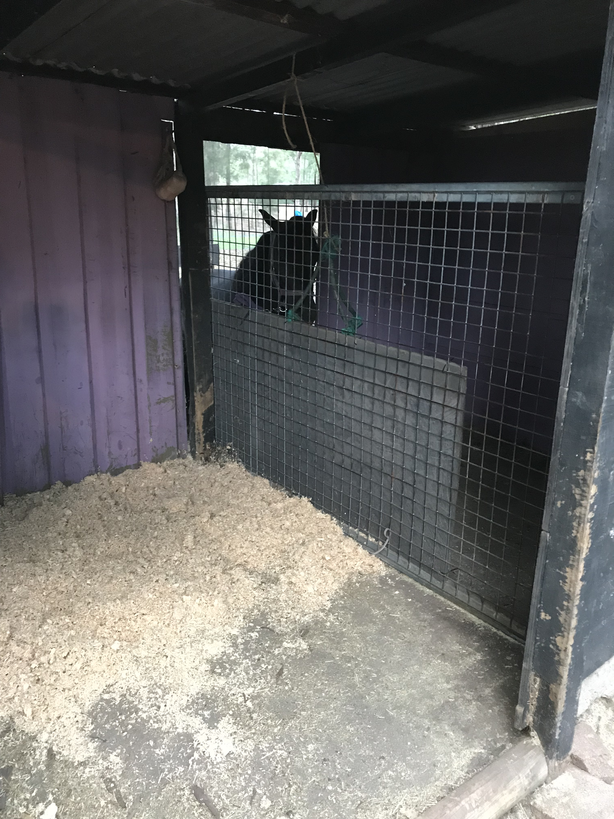
I’d love a new roomie!

Slide 8
?????
Fancy
Squirt

Slide 9

Sensational
Horses
Awesome
Nationals
Generosity
Rewards
Inspirational
Lucky
Achievements

Slide 10

Supreme
Amazing
Presentation
Perfect
Honor
Imhr
Reputation
Expertise
Performance
Ability
Rewarding
Kind

Slide 11
#HusbandCantSayNoIfIWin
#NoOneCouldLoveItMoreThanMe
#SomeLuckyEntrant
#IMHRNATS2019MN1883

Slide 12
Thank you Shangrila and Sapphire Park studs, for this generous opportunity for one lucky amateur .
I'm looking forward to meeting my new baby!!

